Slide 1
Agenda
i. | What we’re hearing
ii. | Where we should go from here: a hypothesis
iii. | Demo How might we collect actionable information and make it easy to use?
iv. | Your feedback
v. | Wrap up

Slide 2
What are we hearing?

Slide 3
Themes to focus on
Improve the quality and breadth of data.
Collaborate across silos.
Make information easy to digest & navigate.
Connect the dots.
Get people to care.
Tell us what you need.
— This working group
— This Administration
— See appendix for ideation boards

Slide 4
Where should we go from here?

Slide 5
A hypothesis about impact
1
Collect actionable, lightly structured information about goal status, blockers, and how people can help
Improve the quality and breadth of data.
Have agencies characterize the status of their goals in consistent, nonjudgmental, intuitive terms and give them the option to describe what’s in their way and how people can help them succeed.
Make information easy to digest & navigate.
Get people to care.
Why start here? Before we race to incorporate agencies’ machine-readable datasets, let’s unlock the value of what we uniquely collect and consolidate.
— This working group
— See appendix for ideation boards
A “goals” dataset, properly contextualized, could be the foundation for relating all kinds of information to specific objectives and shifts in strategic progress—an incredible capability for organizational intelligence.

Slide 6
A hypothesis about impact
Didn’t we try that already?
Not quite. Under this approach, agencies self-report their goal status and do not have to learn a new technology.
Improve the quality and breadth of data.
Make information easy to digest & navigate.
Download OMB templates
We won’t mess with this too much.
We can collect standardized information via a Word-based “cover sheet” compatible with existing agency workflows.
Get people to care.
Fill out templates
— This working group
— See appendix for ideation boards
Circulate internally for review and incorporate comments
Upload files to MAX to initiate OMB review & approval

Slide 7
A hypothesis about impact
Improve the quality and breadth of data.
Build with users and adapt the design choices of popular content platforms to improve wayfinding, comprehension, and “matchmaking”
2
Make information easy to digest & navigate.
Get people to care.
— This working group
— See appendix for ideation boards

Slide 8
A hypothesis about impact
Improve the quality and breadth of data.
Get people to care by solving problems for them
3
Make information easy to digest & navigate.
Get people to care.
— This working group
— See appendix for ideation boards

Slide 9
A hypothesis about impact
It takes time to summarize progress
It takes time to diagnose the problem
Improve the quality and breadth of data.
It takes time to figure out how to help
Make information easy to digest & navigate.
It takes time to find a collaborator
Get people to care.
It takes time to connect the dots
— This working group
It takes time to tell people what you need
— See appendix for ideation boards
It takes too much time.
Maybe performance information can help.

Slide 10
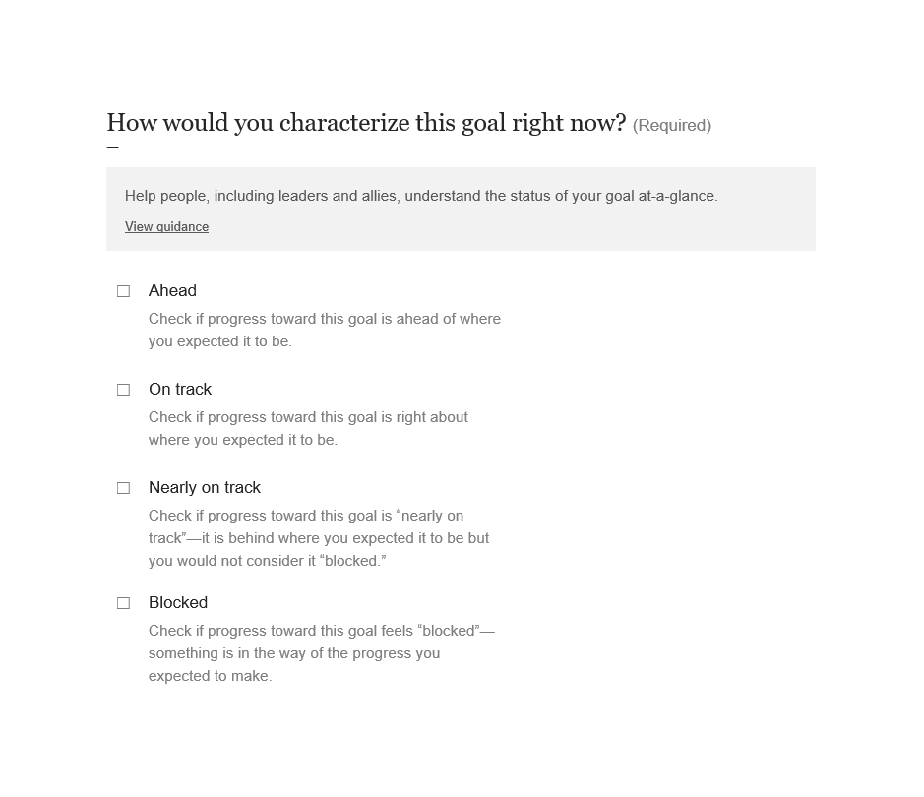
 | Demo APG “cover sheet” See attachment

Slide 11
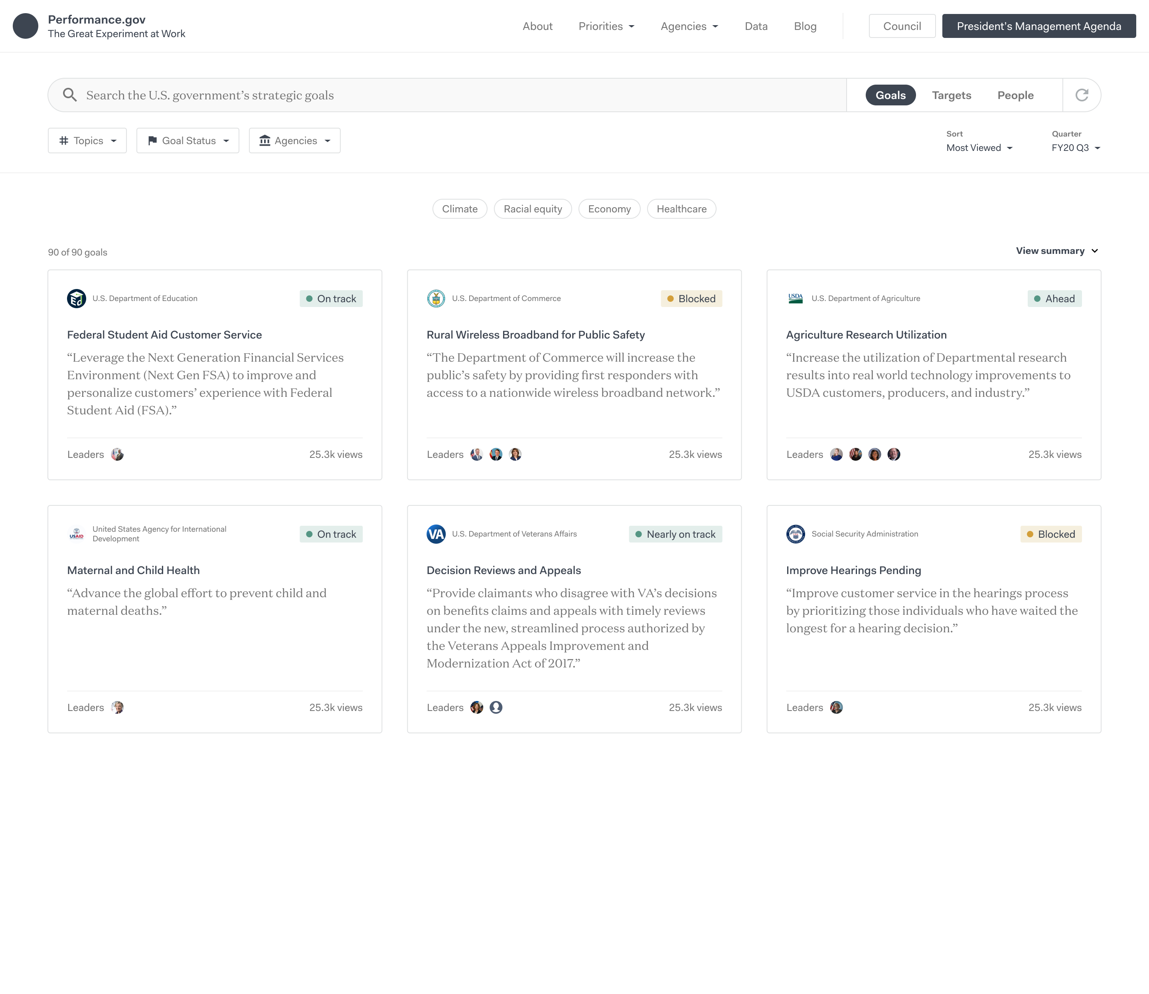
 | Demo performance.gov/browse Click image to view mockup

Slide 12
Wanted: your feedback
— Cover Sheet
— performance.gov/browse
— Let’s discuss for 15 minutes
— Let’s discuss for 15 minutes
Are there scenarios in which this would be useful?
Are there scenarios in which this would be useful?
What is not useful?
What is not useful?
Should this information be shared publicly?
What would you look for, if anything?
How would this “go over” at your agencies?
How would this “go over” at your agencies?

Slide 13
Wanted: your feedback
— Cover Sheet
— performance.gov/browse
— Let’s discuss for 15 minutes
— Let’s discuss for 15 minutes
Are there scenarios in which this would be useful?
Are there scenarios in which this would be useful?
What is not useful?
What is not useful?
Should this information be shared publicly?
What would you look for, if anything?
How would this “go over” at your agencies?
How would this “go over” at your agencies?

Slide 14
Wrap up
Thank you!

